Slide 1

DEVELOPMENT OF A COMPREHENSIVE MOBILE APPLICATION FOR IOEPC
Presented By:
Sangyog Puri (PUR077BCT023)
Sanskar Rijal (PUR077BCT084)
Sujan Nainwasti (PUR077BCT095)
Vision Peer Chaudary (PUR077BCT096)

Slide 2
Introduction
The Institute of Engineering Purwanchal Campus (IOEPC) lacks a centralized platform for academic and administrative services, leading to missed communications and inefficiencies.
Our project aims to develop a mobile application that integrates these services, providing real-time updates and improving accessibility for students and faculty.

Slide 3
Problem Statement
The current systems at IOEPC are fragmented, relying on offline methods and social media, leading to inefficiencies and missed communications.
There is no centralized platform for notices, schedules, and library management, making it difficult for students and faculty to access essential information promptly.

Slide 4





What the project entails?
A mobile app, developed using Kotlin, for student and teacher.
A web app, developed using React, for administrator
Backend using Node.js and Express.js, with MongoDB as database.

Slide 5
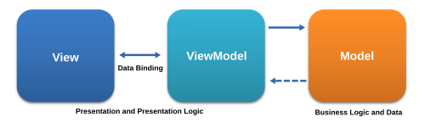
What appears on the screen (frontend)?
Model View ViewModel

Slide 6
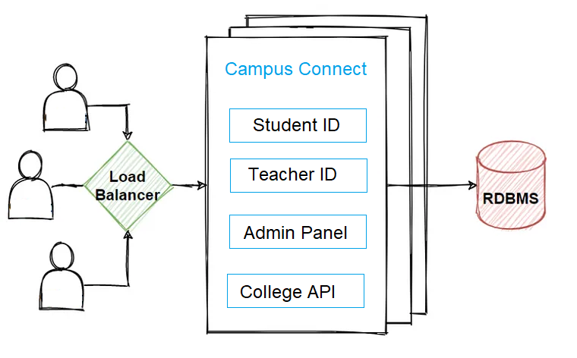
What’s going under the hood (backend architecture)?
Monolithic Architecture

Slide 7
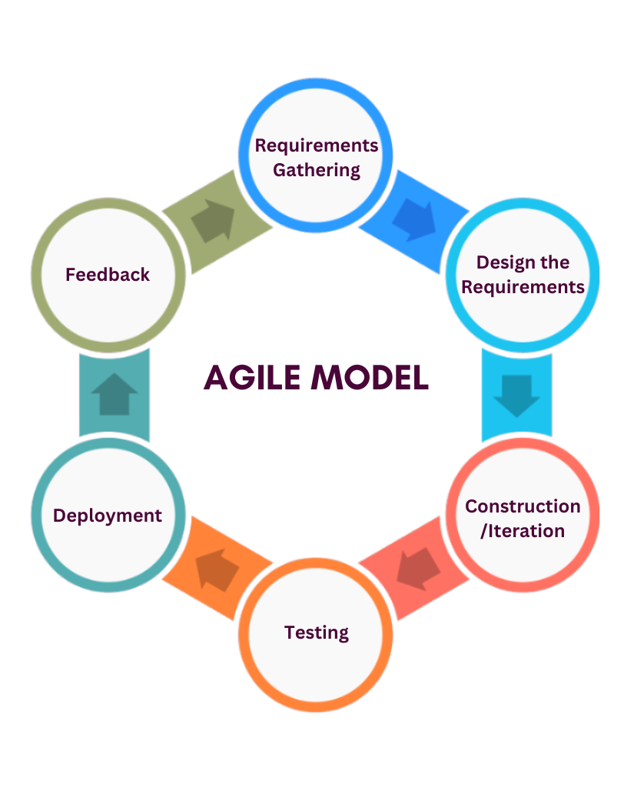
Methodology

Slide 8

Objectives
Reduce the dependency on social media and class representatives
Provide real-time updates and timely information to students
Offer a scalable and integrable solution that can be easily enhanced in the future to accommodate additional services and functionalities.
Centralize library management and other college-related work, streamlining processes and improving accessibility

Slide 9
Thank You!
Questions?
Feedback

